Slide 1
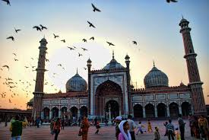
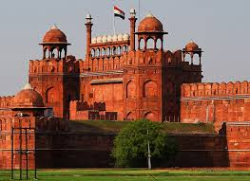
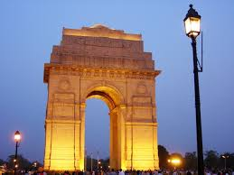
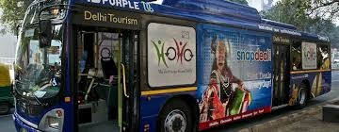
Hop On Hop Off Delhi Sightseeing Service

Slide 2
Presented By:
KAJAL PATYAL
01811604418
MADHVEE
02011604418

Slide 3
Introduction
Delhi Sightseeing at your convenience. We provide platform to choose among various packages and enjoy the tour of National Capital of India and make the most of your journey.

Slide 4
Objective
This project aims to provide a platform to choose the best suited packages to visit and explore more than 20 best tourist spots in Delhi ( e.g. Qutub Minar, Red Fort, Jama Masjid, India Gate, etc) according to user’s convenience and requirements.

Slide 5
Features
Login module:
Customer logins to make a booking.
View package Module:
The admin and customer can view the various packages provided by the system.
View Booking:
Admin can view the bookings made by the customers.
Book Package:
Customer can choose the package according to his convenience.
Update package:
The admin can modify the packages.

Slide 6
Technology used for Development
Front end:
HTML
CSS
Bootstrap
Javascript
Backend:
Xampp Database Server
Php

Slide 7
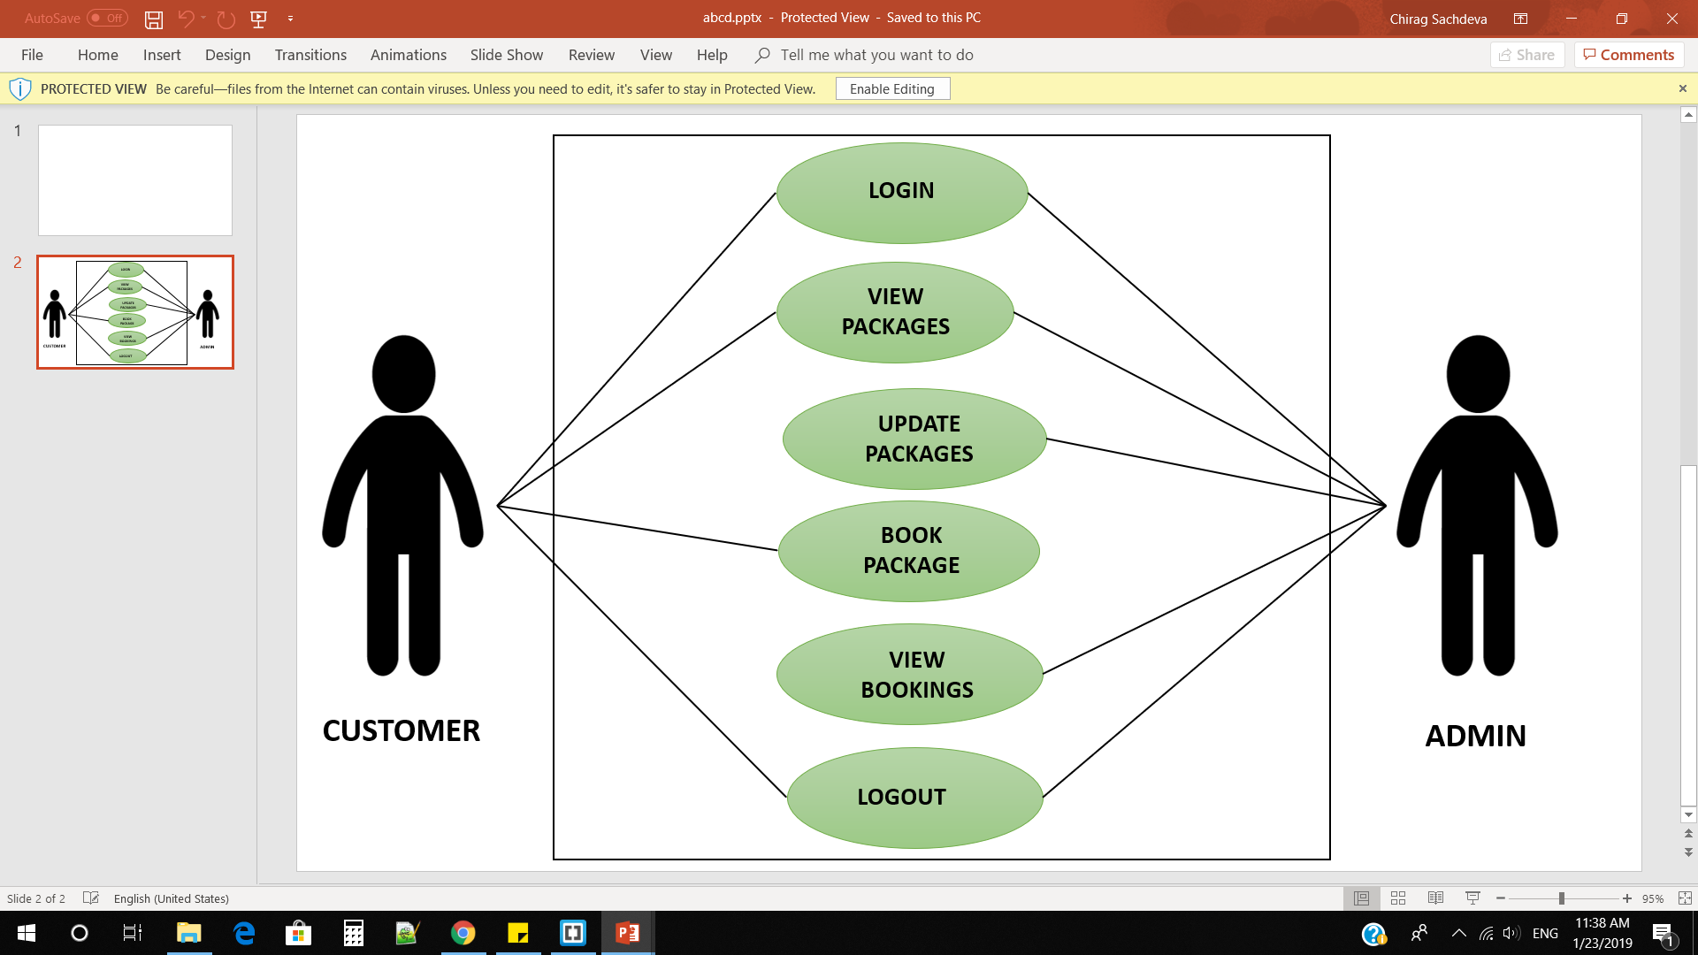
Use Case
HOHO SYSTEM

Slide 8
Entity
Relationship
Diagram

Slide 9
Mobile
C-id
PName
email
Password
P-id
Bprice
Name
Packages
Customer
M
Books
N
TravelDate
Viewed By
A-Id
Pwd
Seats
Price
Admin

Slide 10
CONTEXT LEVEL DFD

Slide 11
HOHO
Login Details
Login Details
Customer
Admin
Login Authentication
Login Authentication
Booking Details
Package Details
Booking Status
Package Status, Bookings
HOHO
Database

Slide 12
Level 1
DFD

Slide 13
View package
Update Package
Package Details
Package
Details
Package
Details
Updated
status
Login
Login Details
Customer
Login Details
Admin
Login Authentication
Login Authentication
No of seats,
tour date,
Selected package
Bookings status
Booking
status
Book Package
Login Credentials
View Bookings
Booking Details

Slide 14
Screenshots

Slide 15
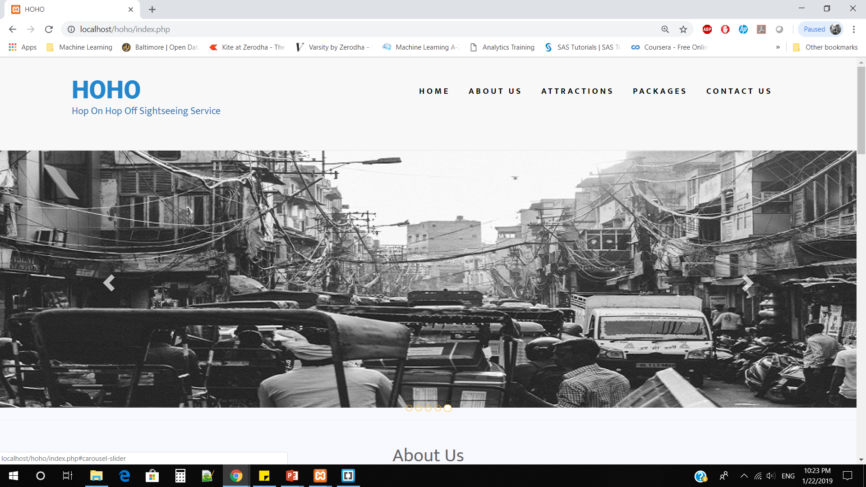

Slide 16
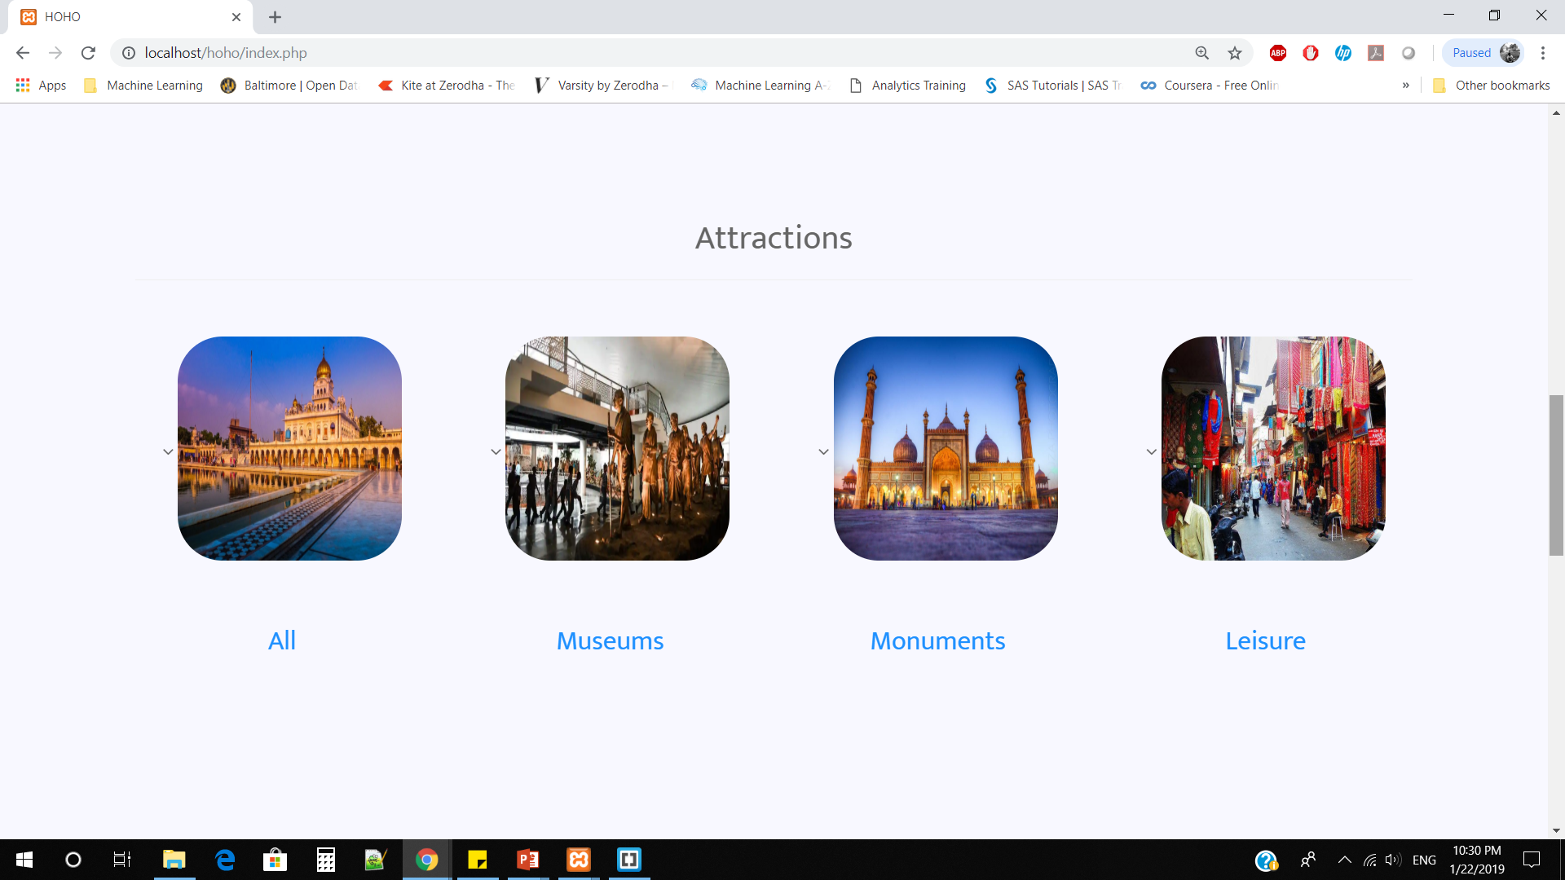

Slide 17
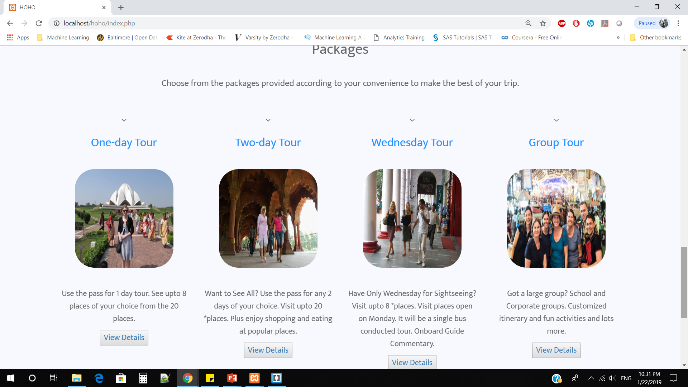

Slide 18
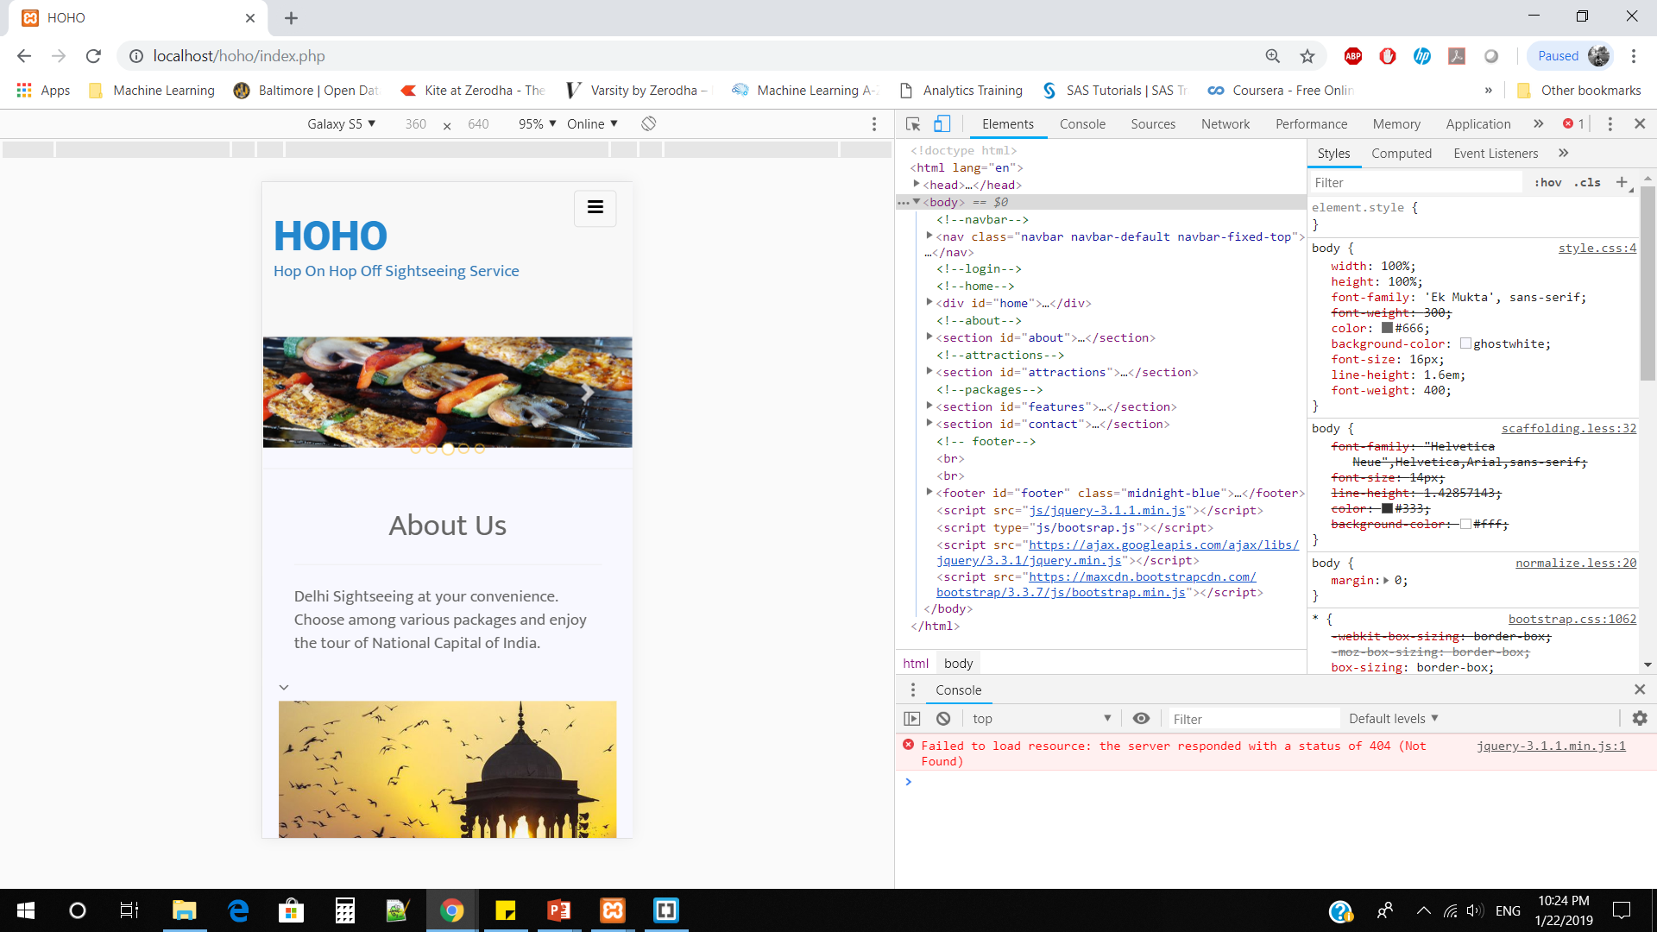
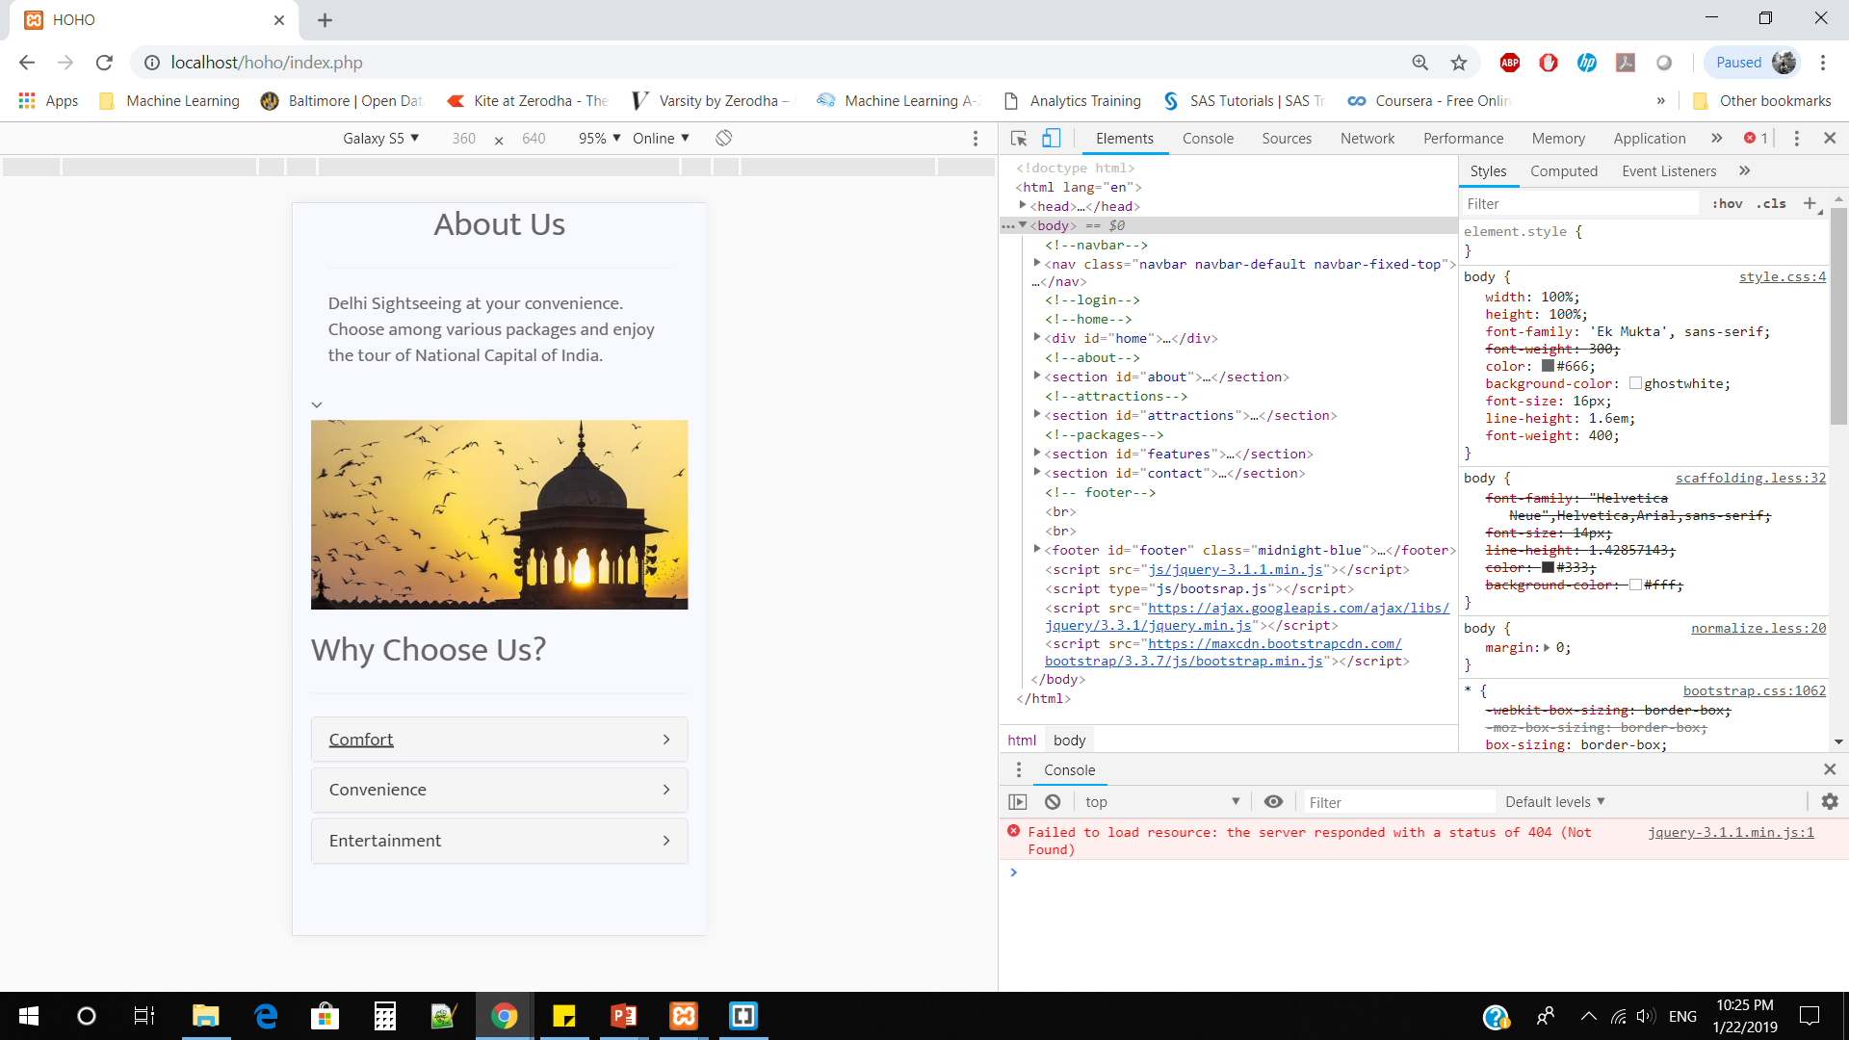

Slide 19
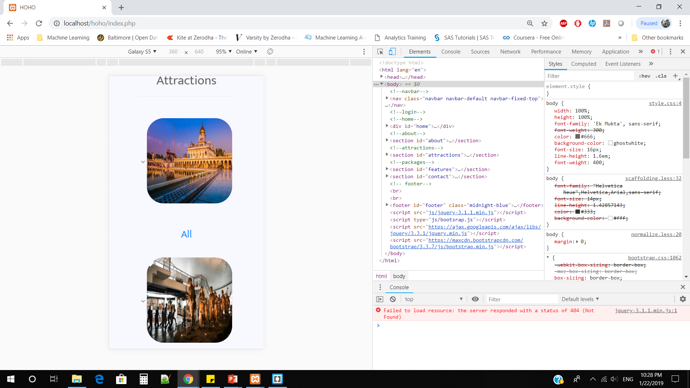
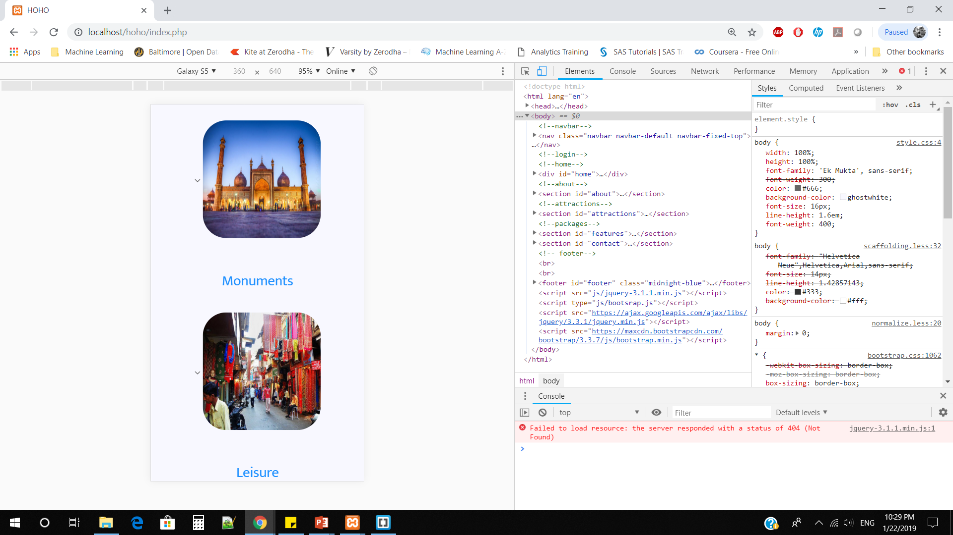

Slide 20
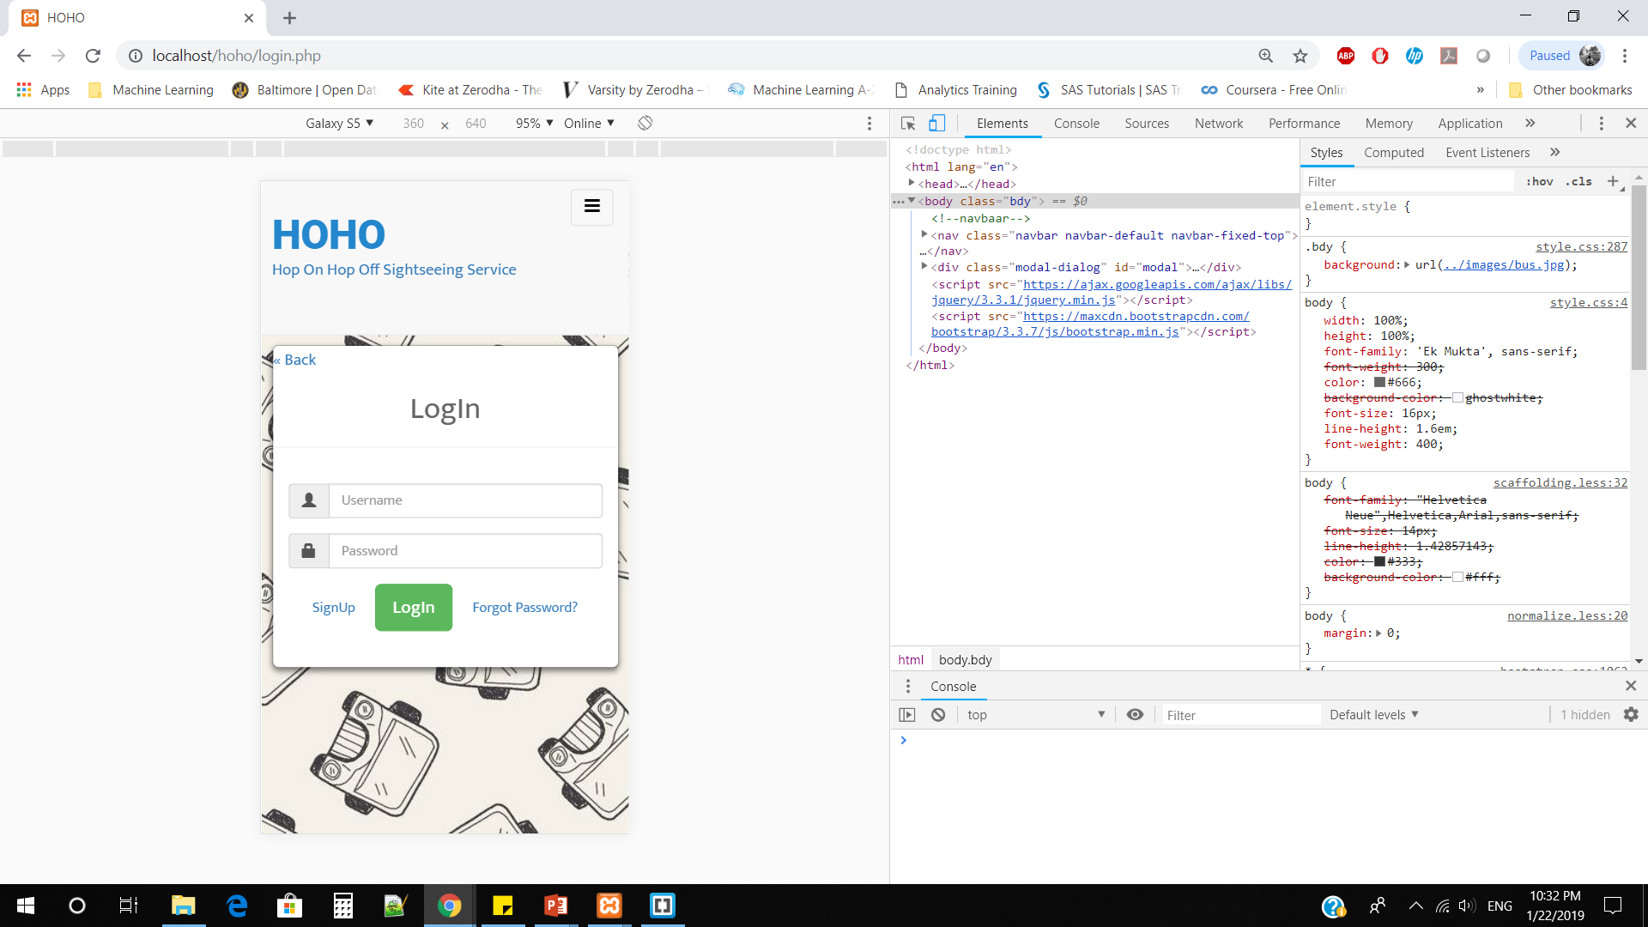
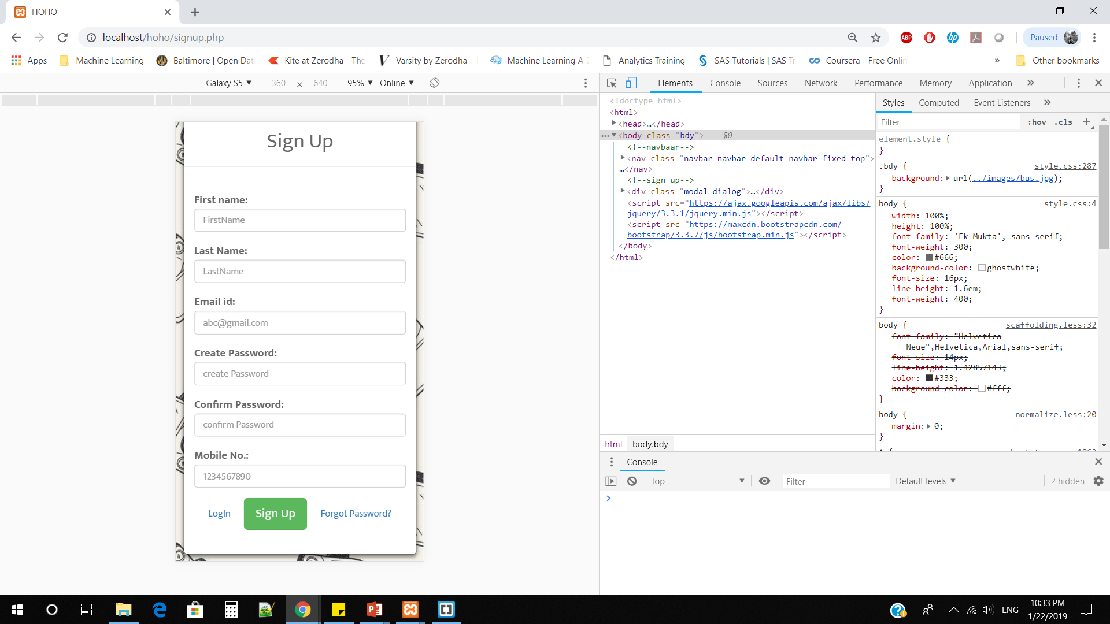

Slide 21
Limitations
User cannot view his booking history.
Booking cancellation by the user is not possible.
Admin control is developed for a single admin.

Slide 22
Future Scope
Developing a payment gateway for the users.
User can view his previous booking.
Improved user experience.

Slide 23
References
https://www.tutorialspoint.com/
https://www.w3schools.com/
http://www.xamppserver.com/
Httpd.apache.org/docs/2.0/tutorials.html

